Slide 1
Customer Review Analysis
British Airways
By Usman Arif

Slide 2
Customer Reviews
A total of 1000 latest customer reviews for British Airways were taken using Web Scraping (Beautiful Soup) from www.airlinequality.com
The Reviews were saved as a data frame and Data processing was done on then to eliminate unnecessary information and to clean the data.
To Analyze the reviews sentimental analysis were performed to check the customer reviews.
Then using topic modelling topics were assigned to these reviews. Reviews were distributed into 5 Topics using LDA Topic Modelling.
Then further analysis were performed to analyze sentiments related to each topic to find areas that require urgent attention and have room for improvement.

Slide 3
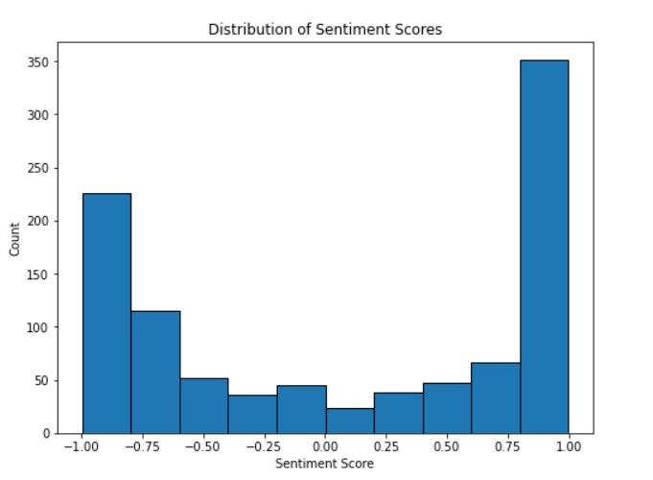
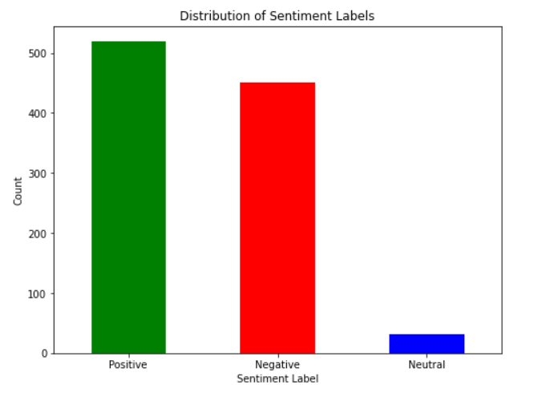
Sentimental Analysis of 1000 Reviews
Sentiment Score from -1.0 to -0.1 was classified as negative, -0.1 to 0.1 as neutral and 0.1 to 1.0 as positive

Slide 4
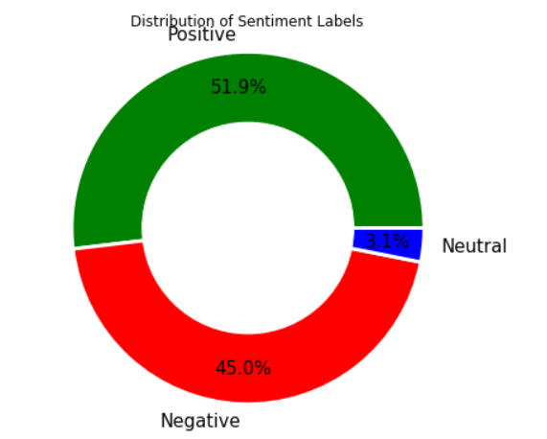
Sentimental Analysis of 1000 Reviews

Slide 5
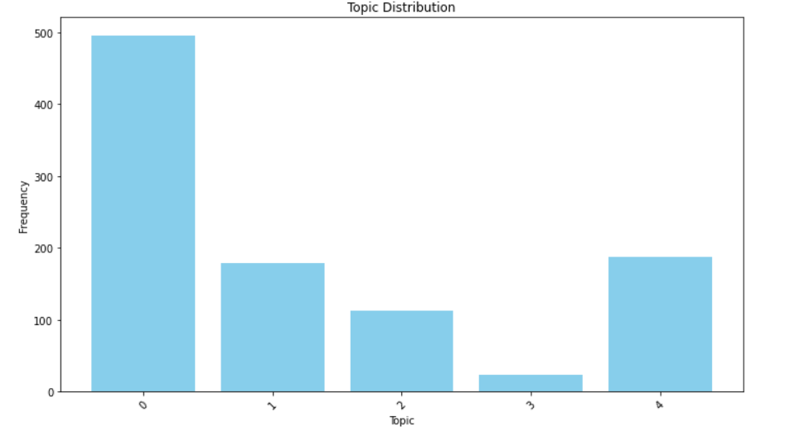
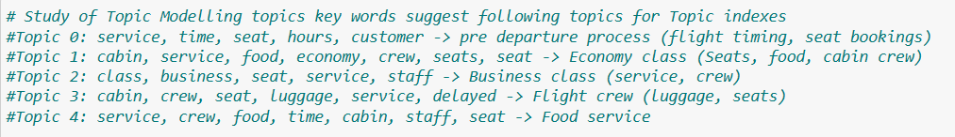
Topic Modelling

Slide 6
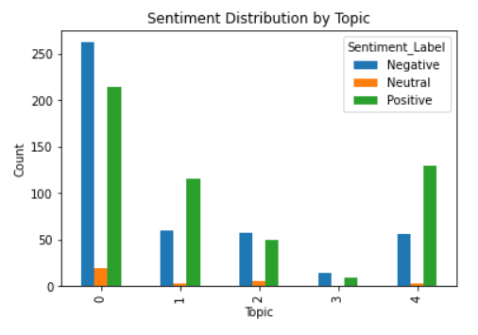
Topic Modelling

Slide 7
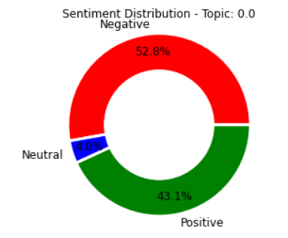
Topic 0: pre departure process (flight timing, seat bookings)

Slide 8
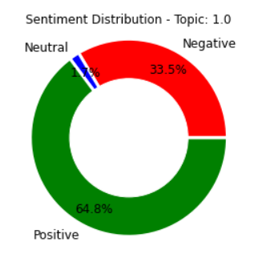
Topic 1: Economy class (Seats, food, cabin crew)

Slide 9
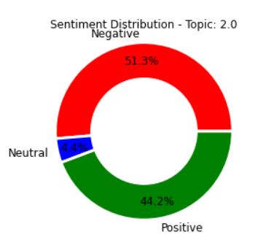
Topic 2: Business class (service, crew)

Slide 10
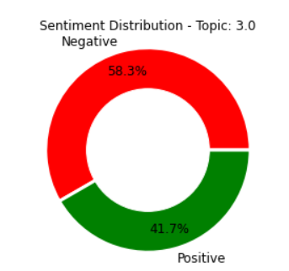
Topic 3: Cabin crew, luggage handling & seats

Slide 11
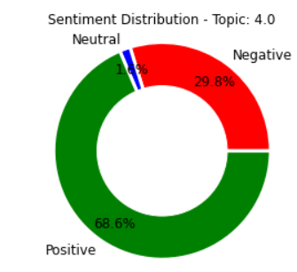
Topic 4: Food service

